Slide 1
A reasonable order for parameter tuning in neural networks

Slide 2
Important note:
The order and importance of the hyperparameter is dependent upon the dataset. There is no one best way to optimize the hyperparameters.

Slide 3
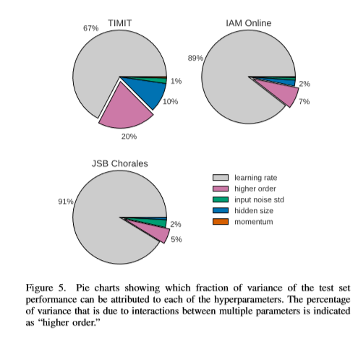
Some empirical results
TIMIT Acoustic-Phonetic Continuous Speech Corpus
IAM On-Line Handwriting Database
https://archive.ics.uci.edu/ml/datasets/Bach+Choral+Harmony
Higher order = interactions
https://arxiv.org/abs/1503.04069

Slide 4
One suggested order
Optimizer
Learning rate
Activation function
Batch size
Input noise
Network design -number of hidden layers and number of neurons
Regularizers - (L1, L2, dropout etc.)

Slide 5
Example (sort of):
When you replace sigmoid or tanh with ReLU, typically you will also need to:
Decrease your learning rate significantly, usually by 1/100th. This is because ReLU output grows without bound and is much less resistant to high learning rates.
Increase number of parameters (i.e. weights, nodes) by around 2X or more. This is because of dead relu issue.
You might have to increase number of epochs due to much lower LR.
You will typically need better initialization method than random init, such as Glorot init or He init. Often you can get by without this but at expense of much slower convergence.
Very likely you will also need more stronger regularization such as dropout, again because of larger number of parameters and increased numbers of epochs.
In summary, things are not as simple as swapping sigmoid/tanh with ReLU. As soon as you add ReLU, you need above changes to compensate for other effects.
https://stats.stackexchange.com/questions/225748/does-relu-layer-work-well-for-a-shallow-network/354649#354649

Slide 6
References
https://stats.stackexchange.com/questions/369104/what-is-a-sensible-order-for-parameter-tuning-in-neural-networks
https://arxiv.org/abs/1503.04069
https://stats.stackexchange.com/questions/225748/does-relu-layer-work-well-for-a-shallow-network/354649#354649
https://stats.stackexchange.com/questions/160479/practical-hyperparameter-optimization-random-vs-grid-search
https://machinelearningmastery.com/train-neural-networks-with-noise-to-reduce-overfitting/
https://datascience.stackexchange.com/questions/5706/what-is-the-dying-relu-problem-in-neural-networks
https://stats.stackexchange.com/questions/225748/does-relu-layer-work-well-for-a-shallow-network/354649#354649

